Slide 1

Sixth Edition
Chapter 14
Single-Case Experimental
Research Designs

Slide 2
Introduction
Single-subject designs (single-case designs): research designs that use the results from a single participant
Establish the existence of cause-and-effect relationships
  Must manipulate an IV and control extraneous variables to prevent alternative explanations for the research results

Slide 3
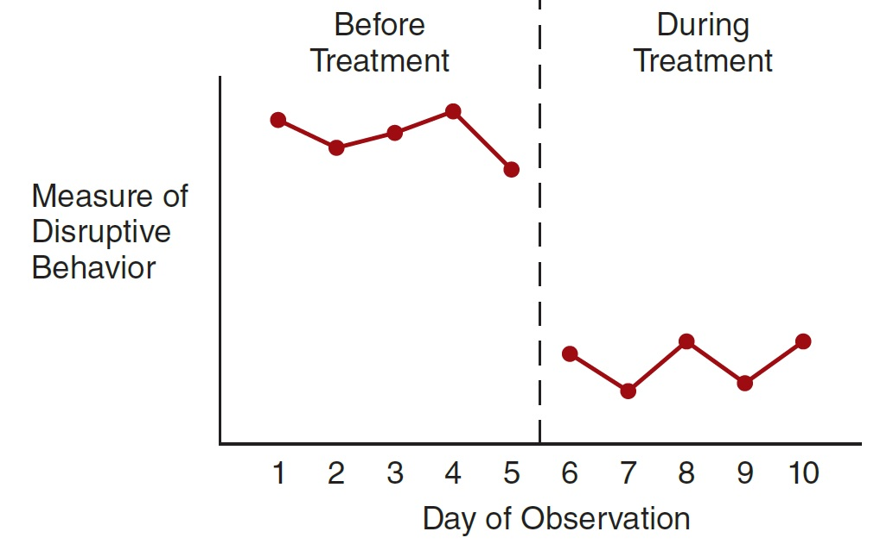
Evaluating the Results from a Single-Case Study
Data is evaluated in a simple graph since statistical tests for significance cannot be used
B
A
Notes:
However, such a graph by itself is not enough to show that the treatment caused a change in behavior
No control over extraneous variables
Could be the result of chance
Phase: series of observations of the same individual under the same conditions
Consistent level
A series of measurements ► all nearly the same magnitude
Graphed data points cluster around a horizontal line
Consistent trend
Differences from one measurement to the next ► consistently in the same direction and nearly the same magnitude
Graphed data points cluster around a sloping line
The degree to which the observations show a pattern of consistent level or consistent trend
Stable data may show minor variations from a perfectly consistent pattern
Variations should be relatively small and the linear pattern relatively clear

Slide 4
Phases and Phase Changes
Phase: series of observations of the same individual under the same conditions
Baseline observations are made when no treatment is being administered
  Baseline phase: a series of baseline observations
    Identified by the letter A

Slide 5
Treatment Observations
Observations made when a treatment is being administered
Treatment phase: a series of treatment observations
  Identified by the letter B
Designating different phases by different letters
  Allows researchers to describe the phases in a study by using a sequence of letters

Slide 6
Level and Trend
Consistent level
  A series of measurements ► all nearly the same magnitude
    Graphed data points cluster around a horizontal line
Consistent trend
  Differences from one measurement to the next ► consistently in the same direction and nearly the same magnitude
    Graphed data points cluster around a sloping line

Slide 7
Stability
The degree to which the observations show a pattern of consistent level or consistent trend
Stable data may show minor variations from a perfectly consistent pattern
  Variations should be relatively small and the linear pattern relatively clear

Slide 8
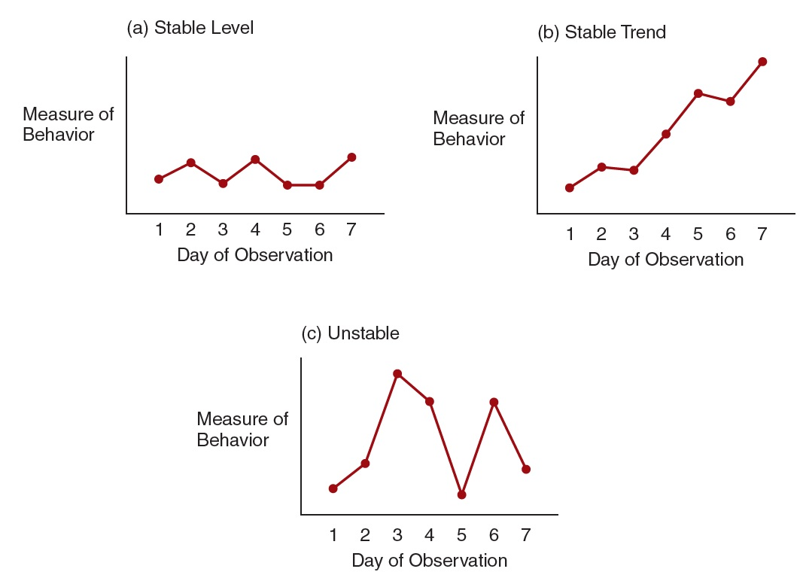
Three Patterns of Results in One Phase of a Single-Subject Study
Notes:
Figure 14.3 Three Patterns of Results for the Data from One Phase in a Single-Subject Research Study
(a) A stable level (b) A stable trend (c) Unstable data

Slide 9
Dealing with Unstable Data (1 of 2)
Strategies:
  Wait until the data stabilize
  Average a set of two or more observations
  Look for patterns within the inconsistence

Slide 10
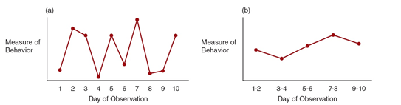
Dealing with Unstable Data
Notes:
Strategies:
Wait until the data stabilize
Average a set of two or more observations
Look for patterns within the inconsistence

Slide 11
Changing Phases
Phase change: a manipulation of the independent variable
  Accomplished by:
    Implementing a new treatment
    Withdrawing a treatment
    Changing a treatment
  Initiates a new phase in which the researcher collects observations under new conditions

Slide 12
Deciding When to Change Phases
When a clear pattern has emerged from the preceding phase
  Consider the participants’ responses
    If they are improving without treatment, don’t implement the treatment
    If they are deteriorating quickly, implement the treatment right away
    If the treatment produces immediate and severe deterioration, cease or modify treatment immediately

Slide 13
Visual Inspection Techniques (1 of 2)
Characteristics that help determine whether there is a meaningful change between phases:
  Change in average level
  Immediate change in level
  Change in trend
  Latency of change

Slide 14
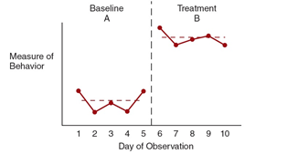
Visual Inspection Techniques (2 of 2)
Notes:
The horizontal dashed lines in each phase correspond to the average level. A clear difference between averages is a good indication of a real difference between phases. Also note the large difference between the final point in the baseline phase and the first point in the treatment phase. The difference also indicates that the participant’s behavior changed when the treatment was introduced.

Slide 15
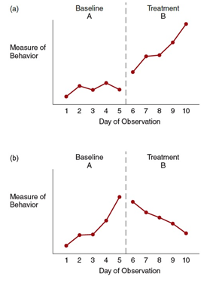
Visual Inspection Techniques (3 of 3)
Notes:
Two Examples of a Clear Change in Trend from One Phase to the Next
(a) A clear change from no trend (consistent level) to an increasing trend.
(b) A reversal in trend from increasing to decreasing.

Slide 16
Reversal Designs: ABAB and Variations
An ABAB design (reversal design) consists of four phases:
  A baseline phase (A), followed by treatment (B), then a return to baseline (A), and finally a repetition of the treatment phase (B)
Goal: to demonstrate that the treatment causes changes in the participant’s behavior

Slide 17
Demonstrating that the ABAB Design Causes a Change in Behavior
The pattern of behavior in each treatment phase
  Clearly different from the pattern in each baseline phase
The changes in behavior from baseline to treatment and from treatment to baseline
  The same for each of the phase-change points in the experiment

Slide 18
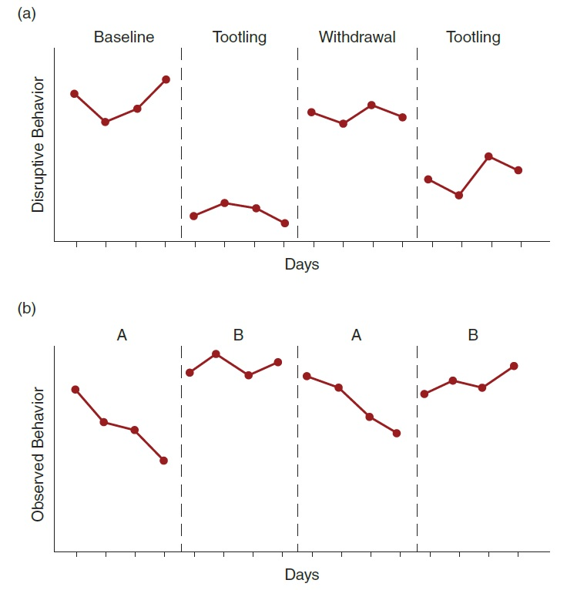
Two Examples of Optimal Results from an ABAB Reversal Design
Notes:
Figure 14.8 Two Examples of Optimal Results from an ABAB Reversal Design
The data show a clear change in level when the treatment is introduced, a clear return to baseline when the treatment is withdrawn, and a clear replication of the treatment effect when the treatment is reintroduced. (b) A similar pattern, except that the treatment stops the baseline trend and restores behavior to a higher, more stable level.
Tootling: a positive behavior intervention where students report their classmates' prosocial behaviors

Slide 19
Limitations of the ABAB Design
Withdrawal from treatment
  May not result in a change in behavior (the patient is cured)
  May result in a slight change but not a return to baseline
  May cause an ethical problem if the treatment is working for the participant

Slide 20
Variations on the ABAB Design
Sometimes researchers add a treatment or modify the sequence of baseline and treatment phases
  Created a complex design
  Researchers must incorporate new treatments into the phase sequence to prove a causal relationship
    ABBCAC, ABCBC, etc.

Slide 21
Multiple-Baseline Designs (1 of 2)
Begin with two simultaneous baseline phases
  Treatment phase is initiated for one baseline
  Baseline observations continue for the other
  The treatment is initiated for the second baseline at a later time
Multiple-baseline across subjects
  The initial baseline phases correspond to the same behavior for two separate participants

Slide 22
Multiple-Baseline Designs (2 of 2)
Multiple-baseline across behaviors
  The initial baseline phases correspond to two separate behaviors for the same participant
Multiple-baseline across situations
  The initial baseline phases correspond to the same behavior in two separate situations

Slide 23
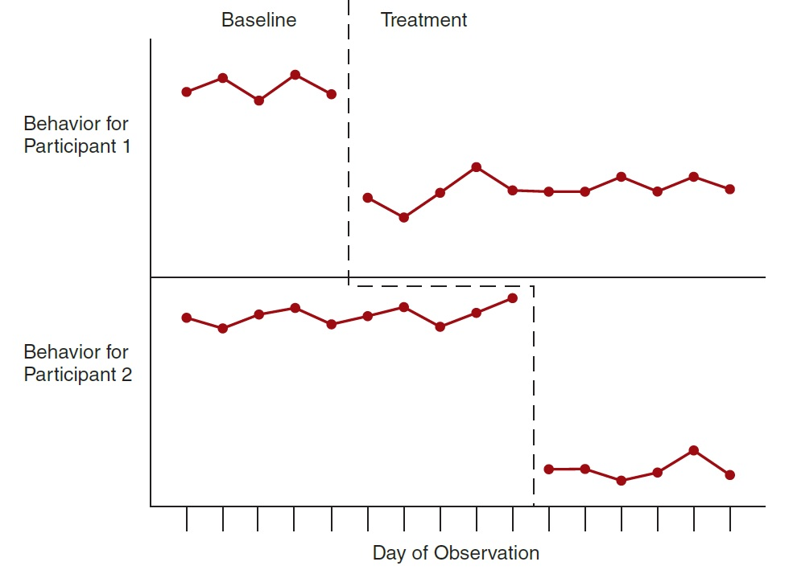
Multiple-Baseline Design—Hypothetical Data Results
Notes:
Hypothetical Data Showing the Results from a Multiple-Baseline Design
The baseline phase begins for two participants simultaneously but continues for one participant after the treatment phase has been started for the other participant.

Slide 24
Component Analysis Designs
Consist of a series of phases
  Each phase adds or subtracts one component of a complex treatment
    Determines how each component contributes to the overall treatment effectiveness
  Component analysis with a reversal design
  Component analysis with a multiple-baseline design

Slide 25
Strengths and Weaknesses of Multiple-Baseline Design
Strengths:
  No return to baseline needed
  Good for long-lasting treatments
Weaknesses:
  It can be difficult to identify similar but independent behaviors
  Results can be compromised by individual differences between participants or between behaviors

Slide 26
General Strengths and Weaknesses of Single-Subject Designs
What are advantages of single-subject designs?
  Allows researchers to establish cause-and-effect relationship with one subject
  Flexibility: the researcher is free to modify the treatment or change to a new treatment if a subject fails to respond to treatment
  No need to standardize treatment across groups—a single subject is used

Slide 27
Disadvantages of Single-Subject Designs
Relationship among variables is for only one subject
  May threaten external validity (generalization)
Multiple, continuous observations are required
Absence of statistical controls
  Reliance on graphs to display data
    Treatment effects must be large and immediate to produce a convincing graph

